Slide 1
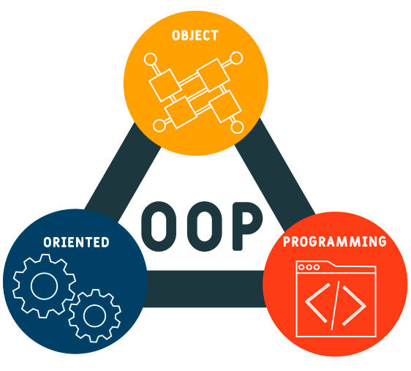
OJBECT ORIENTATION IN JAVA
Java is an object-oriented programming language.

Slide 2

Memory management and garbaje collection
Automatic Memory Management: Java uses a garbage collector to automatically manage memory.

Slide 3

Extensive Standard Library
Java comes with an extensive standard library that provides classes and methods for various tasks, from string manipulation to network operations.

Slide 4
JAVA EE and se platform

Slide 5

Java curiosities
Origin of the Name: Java got its name from coffee.

